Slide 1
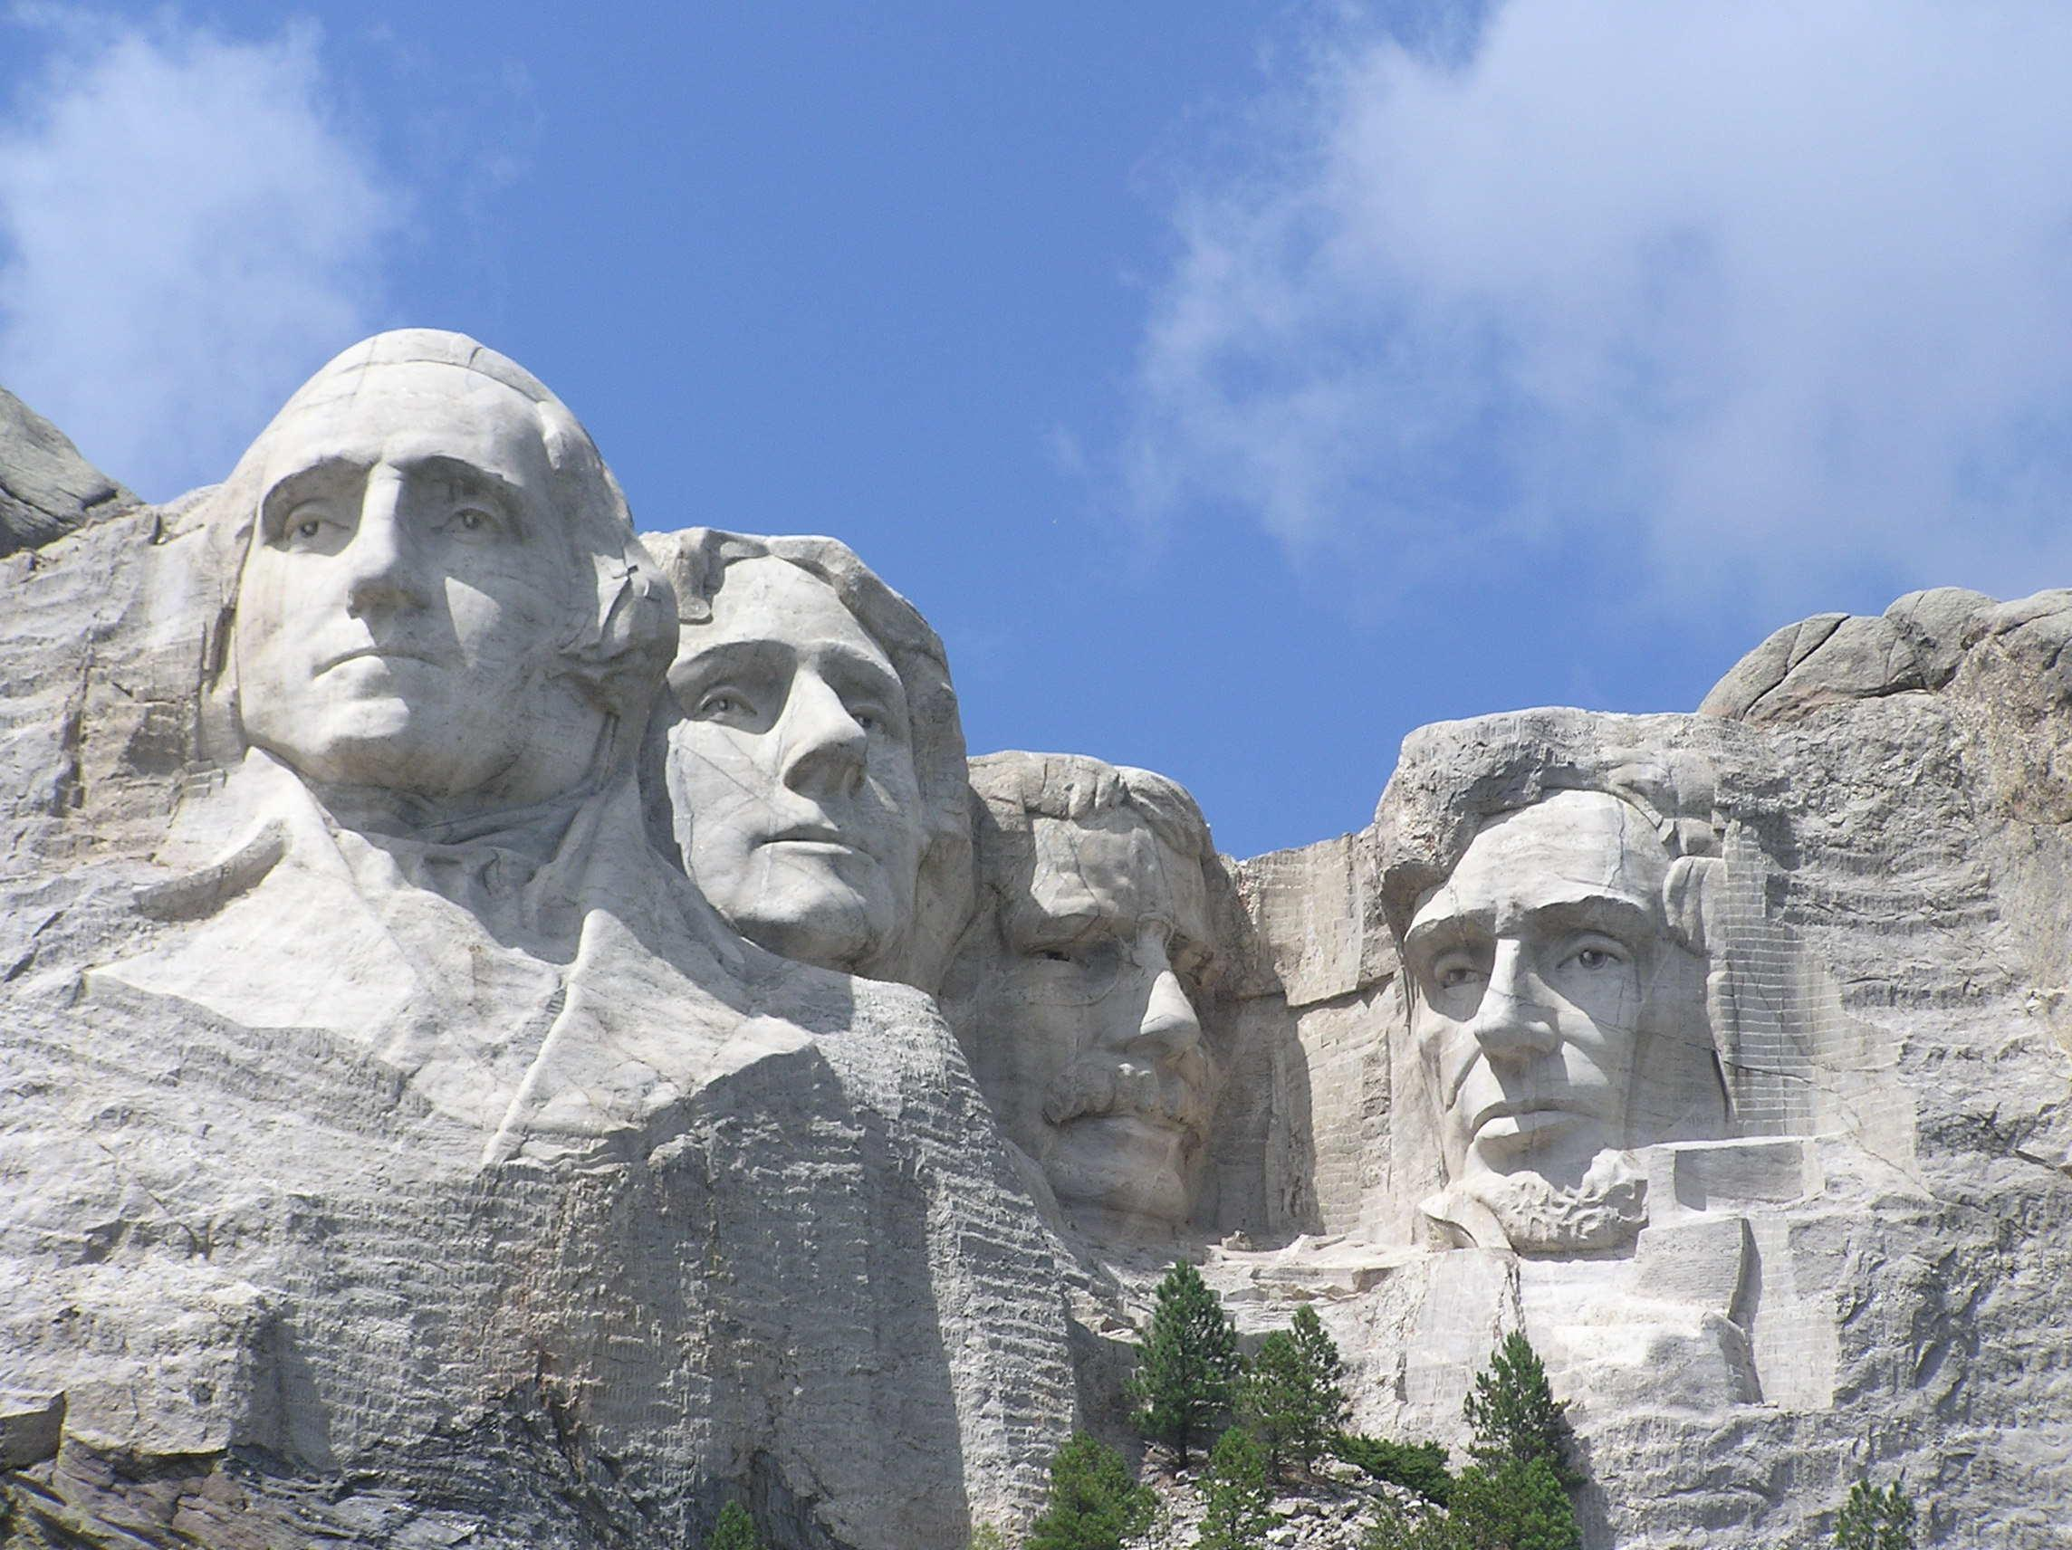
Politics
Business
Entertainment
Science
Sports
Society
Management
Arts
Leadership Excellence
Thoughts From The Greatest Leaders Of All Times
“I start with the premise that the function of leadership is to produce more leaders, not more followers.”
Ralph Nader
CE

Slide 2
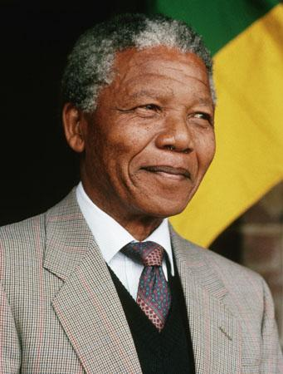
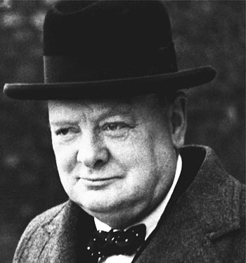
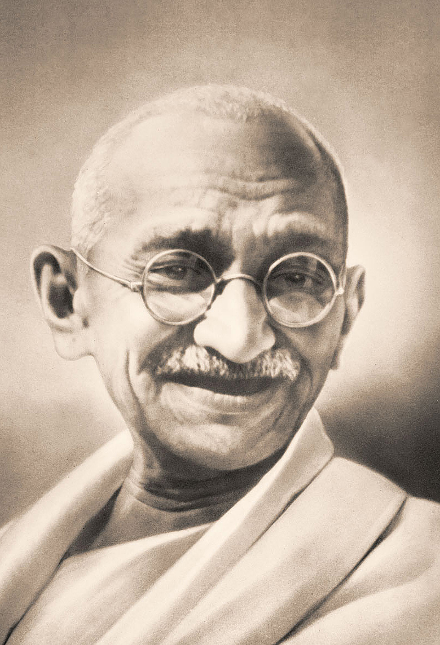
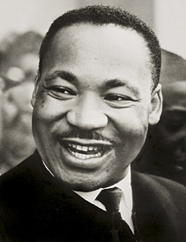
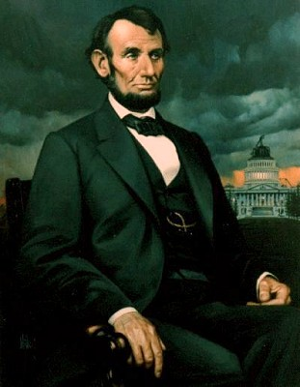
Politics
Business
Entertainment
Science
Sports
Society
Management
Arts
Leadership Excellence
Thoughts From The Greatest Leaders Of All Times
Nelson Mandela
Sir Winston Churchill
M.K.Gandhi
Martin Luther King
Abraham Lincoln
Click on the picture to view their famous quotations

Slide 3
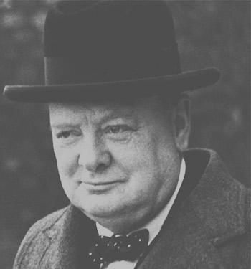
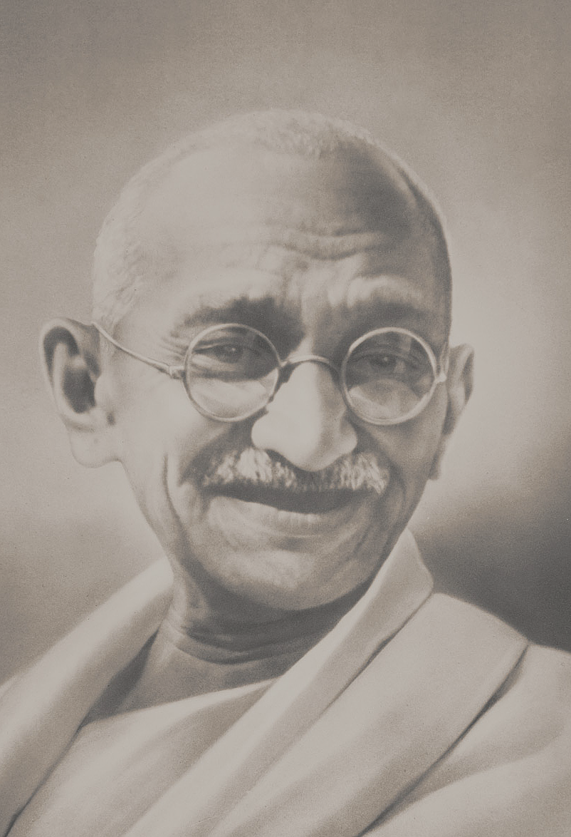
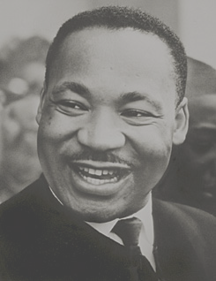
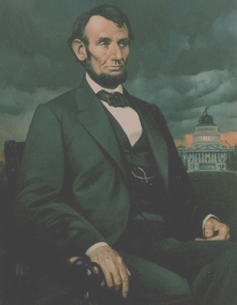
Politics
Business
Entertainment
Science
Sports
Society
Management
Arts
Leadership Excellence
Thoughts From The Greatest Leaders Of All Times
Nelson Mandela
Sir Winston Churchill
M.K.Gandhi
Martin Luther King
Abraham Lincoln
“Education is the most powerful weapon which you can use to change the world.”
Nelson Mandela
Next

Slide 4
Politics
Business
Entertainment
Science
Sports
Society
Management
Arts
Leadership Excellence
Thoughts From The Greatest Leaders Of All Times
Nelson Mandela
Sir Winston Churchill
M.K.Gandhi
Martin Luther King
Abraham Lincoln
“I am not a saint, unless you think of a saint as a sinner who keeps on trying.”
Nelson Mandela
Next

Slide 5
Politics
Business
Entertainment
Science
Sports
Society
Management
Arts
Leadership Excellence
Thoughts From The Greatest Leaders Of All Times
Nelson Mandela
Sir Winston Churchill
M.K.Gandhi
Martin Luther King
Abraham Lincoln
“We must use time wisely and forever realize that the time is always ripe to do right.”
Nelson Mandela
Next

Slide 6

Politics
Business
Entertainment
Science
Sports
Society
Management
Arts
Leadership Excellence
Thoughts From The Greatest Leaders Of All Times
Nelson Mandela
Sir Winston Churchill
M.K.Gandhi
Martin Luther King
Abraham Lincoln
“I have always felt that a politician is to be judged by the animosities he excites among his opponents.”
Sir Winston Churchill
Next

Slide 7
Politics
Business
Entertainment
Science
Sports
Society
Management
Arts
Leadership Excellence
Thoughts From The Greatest Leaders Of All Times
Nelson Mandela
Sir Winston Churchill
M.K.Gandhi
Martin Luther King
Abraham Lincoln
“We make a living by what we get, we make a life by what we give. ”
Sir Winston Churchill
Next

Slide 8
Politics
Business
Entertainment
Science
Sports
Society
Management
Arts
Leadership Excellence
Thoughts From The Greatest Leaders Of All Times
Nelson Mandela
Sir Winston Churchill
M.K.Gandhi
Martin Luther King
Abraham Lincoln
One day President Roosevelt told me that he was asking publicly for suggestions about what the war should be called. I said at once 'The Unnecessary War‘
Sir Winston Churchill
Next

Slide 9
Politics
Business
Entertainment
Science
Sports
Society
Management
Arts
Leadership Excellence
Thoughts From The Greatest Leaders Of All Times
Nelson Mandela
Sir Winston Churchill
M.K.Gandhi
Martin Luther King
Abraham Lincoln
“The empires of the future are the empires of the mind.”
Sir Winston Churchill
Next

Slide 10
Politics
Business
Entertainment
Science
Sports
Society
Management
Arts
Leadership Excellence
Thoughts From The Greatest Leaders Of All Times
Nelson Mandela
Sir Winston Churchill
M.K.Gandhi
Martin Luther King
Abraham Lincoln
“Strength does not come from physical capacity. It comes from an indomitable will.”
M.K.Gandhi
Next

Slide 11
Politics
Business
Entertainment
Science
Sports
Society
Management
Arts
Leadership Excellence
Thoughts From The Greatest Leaders Of All Times
Nelson Mandela
Sir Winston Churchill
M.K.Gandhi
Martin Luther King
Abraham Lincoln
“We must become the change we want to see.”
M.K.Gandhi
Next

Slide 12
Politics
Business
Entertainment
Science
Sports
Society
Management
Arts
Leadership Excellence
Thoughts From The Greatest Leaders Of All Times
Nelson Mandela
Sir Winston Churchill
M.K.Gandhi
Martin Luther King
Abraham Lincoln
“A small body of determined spirits fired by an unquenchable faith in their mission can alter the course of history.”
M.K.Gandhi
Next

Slide 13
Politics
Business
Entertainment
Science
Sports
Society
Management
Arts
Leadership Excellence
Thoughts From The Greatest Leaders Of All Times
Nelson Mandela
Sir Winston Churchill
M.K.Gandhi
Martin Luther King
Abraham Lincoln
“Our scientific power has outrun our spiritual power. We have guided missiles and misguided men.”
Martin Luther King
Next

Slide 14
Politics
Business
Entertainment
Science
Sports
Society
Management
Arts
Leadership Excellence
Thoughts From The Greatest Leaders Of All Times
Nelson Mandela
Sir Winston Churchill
M.K.Gandhi
Martin Luther King
Abraham Lincoln
“Man must evolve for all human conflict a method which rejects revenge, aggression and retaliation. The foundation of such a method is love.”
Martin Luther King
Next

Slide 15
Politics
Business
Entertainment
Science
Sports
Society
Management
Arts
Leadership Excellence
Thoughts From The Greatest Leaders Of All Times
Nelson Mandela
Sir Winston Churchill
M.K.Gandhi
Martin Luther King
Abraham Lincoln
“The ultimate measure of a man is not where he stands in moments of comfort and convenience, but where he stands at times of challenge and controversy.”
Martin Luther King
Next

Slide 16
Politics
Business
Entertainment
Science
Sports
Society
Management
Arts
Leadership Excellence
Thoughts From The Greatest Leaders Of All Times
Nelson Mandela
Sir Winston Churchill
M.K.Gandhi
Martin Luther King
Abraham Lincoln
“Force is all-conquering, but its victories are short-lived.”
Abraham Lincoln
Next

Slide 17
Politics
Business
Entertainment
Science
Sports
Society
Management
Arts
Leadership Excellence
Thoughts From The Greatest Leaders Of All Times
Nelson Mandela
Sir Winston Churchill
M.K.Gandhi
Martin Luther King
Abraham Lincoln
“Always bear in mind that your own resolution to succeed is more important than any one thing.”
Abraham Lincoln
Next

Slide 18
Politics
Business
Entertainment
Science
Sports
Society
Management
Arts
Leadership Excellence
Thoughts From The Greatest Leaders Of All Times
Nelson Mandela
Sir Winston Churchill
M.K.Gandhi
Martin Luther King
Abraham Lincoln
“Am I not destroying my enemies when I make friends of them?”
Abraham Lincoln
Next

Slide 19
Politics
Business
Entertainment
Science
Sports
Society
Management
Arts
Leadership Excellence
Thoughts From The Greatest Leaders Of All Times
Nelson Mandela
Sir Winston Churchill
M.K.Gandhi
Martin Luther King
Abraham Lincoln
“I am a firm believer in the people. If given the truth, they can be depended upon to meet any national crises. The great point is to bring them the real facts.”
Abraham Lincoln
Next

Slide 20
Politics
Business
Entertainment
Science
Sports
Society
Management
Arts
Leadership Excellence
Thoughts From The Greatest Leaders Of All Times
Nelson Mandela
Sir Winston Churchill
M.K.Gandhi
Martin Luther King
Abraham Lincoln
“When I do good, I feel good; when I do bad, I feel bad, and that is my religion.”
Abraham Lincoln
Next

Slide 21
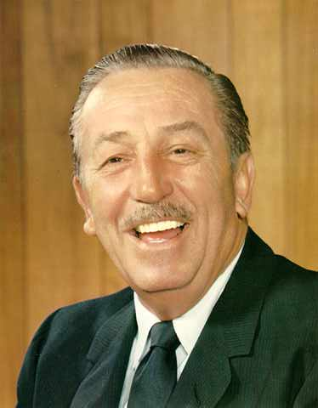
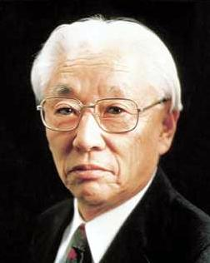
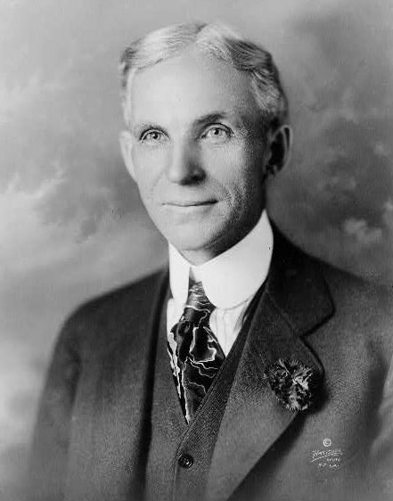
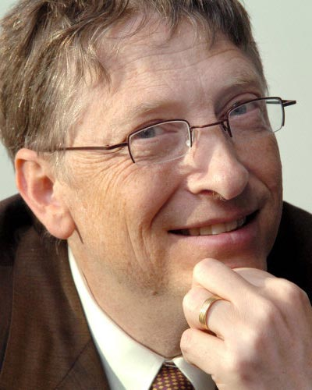
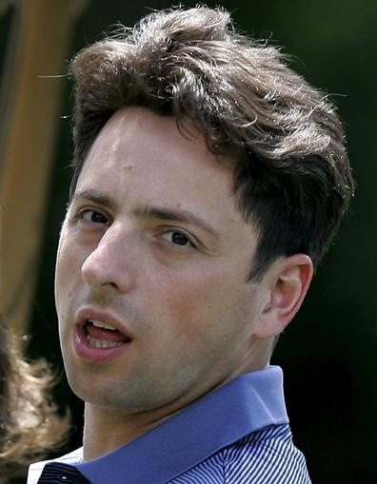
Politics
Business
Entertainment
Science
Sports
Society
Management
Arts
Leadership Excellence
Thoughts From The Greatest Leaders Of All Times
Walt Disney
Disney World
Akio Morita
Sony
Henry Ford
Ford Motors
Bill Gates
Microsoft
Larry Page
Google
Click on the picture to view their famous quotations

Slide 22
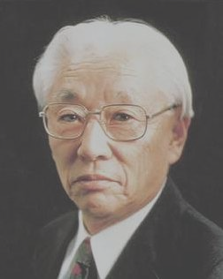


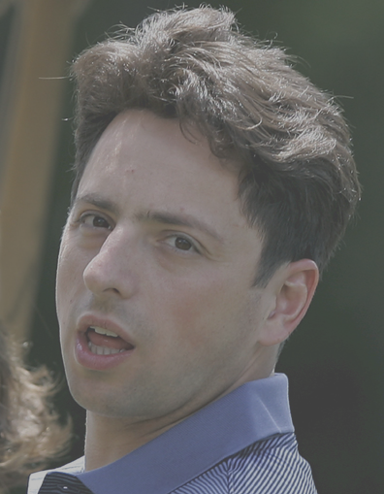
Politics
Business
Entertainment
Science
Sports
Society
Management
Arts
Leadership Excellence
Thoughts From The Greatest Leaders Of All Times
Walt Disney
Disney World
Akio Morita
Sony
Henry Ford
Ford Motors
Bill Gates
Microsoft
Larry Page
Google
“It's kind of fun to do the impossible.”
Walt Disney
Next

Slide 23
Politics
Business
Entertainment
Science
Sports
Society
Management
Arts
Leadership Excellence
Thoughts From The Greatest Leaders Of All Times
Walt Disney
Disney World
Akio Morita
Sony
Henry Ford
Ford Motors
Bill Gates
Microsoft
Larry Page
Google
“I dream, I test my dreams against my beliefs, I dare to take risks, and I execute my vision to make those dreams come true.”
Walt Disney
Next

Slide 24
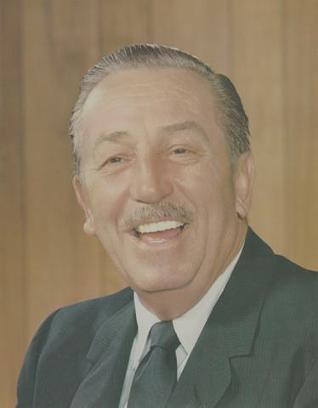
Politics
Business
Entertainment
Science
Sports
Society
Management
Arts
Leadership Excellence
Thoughts From The Greatest Leaders Of All Times
Walt Disney
Disney World
Akio Morita
Sony
Henry Ford
Ford Motors
Bill Gates
Microsoft
Larry Page
Google
“ The company is the pioneer and as such will always be the seeker of unknown.”
Morita
Next

Slide 25
Politics
Business
Entertainment
Science
Sports
Society
Management
Arts
Leadership Excellence
Thoughts From The Greatest Leaders Of All Times
Walt Disney
Disney World
Akio Morita
Sony
Henry Ford
Ford Motors
Bill Gates
Microsoft
Larry Page
Google
“Flawless execution separates us from others.”
Morita
Next

Slide 26
Politics
Business
Entertainment
Science
Sports
Society
Management
Arts
Leadership Excellence
Thoughts From The Greatest Leaders Of All Times
Walt Disney
Disney World
Akio Morita
Sony
Henry Ford
Ford Motors
Bill Gates
Microsoft
Larry Page
Google
“Curiosity is the key to creativity.”
Morita
Next

Slide 27
Politics
Business
Entertainment
Science
Sports
Society
Management
Arts
Leadership Excellence
Thoughts From The Greatest Leaders Of All Times
Walt Disney
Disney World
Akio Morita
Sony
Henry Ford
Ford Motors
Bill Gates
Microsoft
Larry Page
Google
“A business that makes nothing but money is a poor business.”
Henry Ford
Next

Slide 28
Politics
Business
Entertainment
Science
Sports
Society
Management
Arts
Leadership Excellence
Thoughts From The Greatest Leaders Of All Times
Walt Disney
Disney World
Akio Morita
Sony
Henry Ford
Ford Motors
Bill Gates
Microsoft
Larry Page
Google
“Failure is simply the opportunity to begin again, this time more intelligently.”
Henry Ford
Next

Slide 29
Politics
Business
Entertainment
Science
Sports
Society
Management
Arts
Leadership Excellence
Thoughts From The Greatest Leaders Of All Times
Walt Disney
Disney World
Akio Morita
Sony
Henry Ford
Ford Motors
Bill Gates
Microsoft
Larry Page
Google
“If there is any one secret of success, it lies in the ability to get the other person's point of view and see things from that person's angle as well as from your own.”
Henry Ford
Next

Slide 30
Politics
Business
Entertainment
Science
Sports
Society
Management
Arts
Leadership Excellence
Thoughts From The Greatest Leaders Of All Times
Walt Disney
Disney World
Akio Morita
Sony
Henry Ford
Ford Motors
Bill Gates
Microsoft
Larry Page
Google
“As we look ahead into the next century, leaders will be those who empower others.”
Bill Gates
Next

Slide 31
Politics
Business
Entertainment
Science
Sports
Society
Management
Arts
Leadership Excellence
Thoughts From The Greatest Leaders Of All Times
Walt Disney
Disney World
Akio Morita
Sony
Henry Ford
Ford Motors
Bill Gates
Microsoft
Larry Page
Google
“Success is a lousy teacher. It seduces smart people into thinking they can't lose.”
Bill Gates
Next

Slide 32
Politics
Business
Entertainment
Science
Sports
Society
Management
Arts
Leadership Excellence
Thoughts From The Greatest Leaders Of All Times
Walt Disney
Disney World
Akio Morita
Sony
Henry Ford
Ford Motors
Bill Gates
Microsoft
Larry Page
Google
“We've got to put a lot of money into changing behavior.”
Bill Gates
Next

Slide 33
Politics
Business
Entertainment
Science
Sports
Society
Management
Arts
Leadership Excellence
Thoughts From The Greatest Leaders Of All Times
Walt Disney
Disney World
Akio Morita
Sony
Henry Ford
Ford Motors
Bill Gates
Microsoft
Larry Page
Google
“Best is not the end point, but a starting point for innovation.”
Larry Page
Next

Slide 34
Politics
Business
Entertainment
Science
Sports
Society
Management
Arts
Leadership Excellence
Thoughts From The Greatest Leaders Of All Times
Walt Disney
Disney World
Akio Morita
Sony
Henry Ford
Ford Motors
Bill Gates
Microsoft
Larry Page
Google
“Basically, our goal is to organize the world's information and to make it universally accessible and useful.”
Larry Page
Next

Slide 35
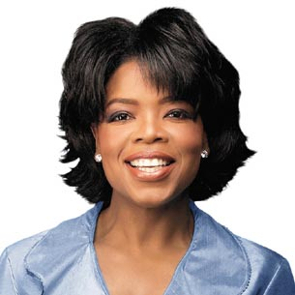
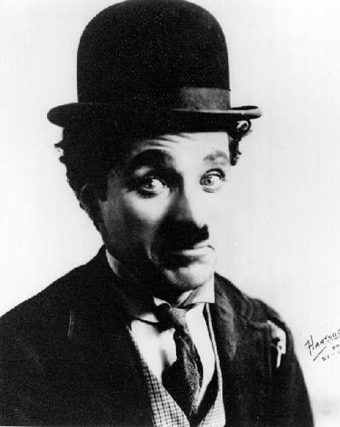
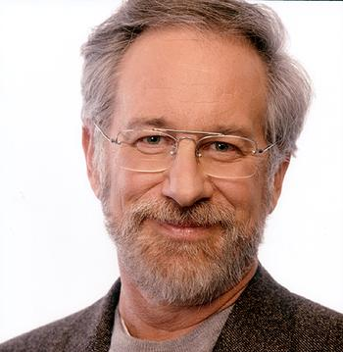
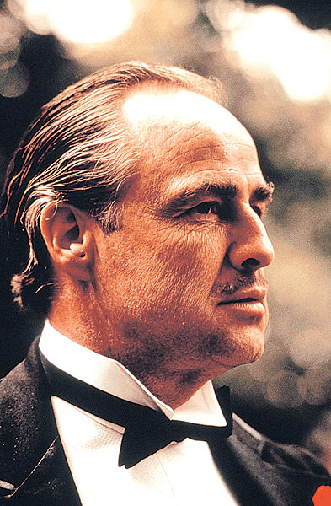
Politics
Business
Entertainment
Science
Sports
Society
Management
Arts
Leadership Excellence
Thoughts From The Greatest Leaders Of All Times
Oprah Winfrey
Charlie Chaplin
Steven Spielberg
Marlon Brando
Click on the picture to view their famous quotations

Slide 36
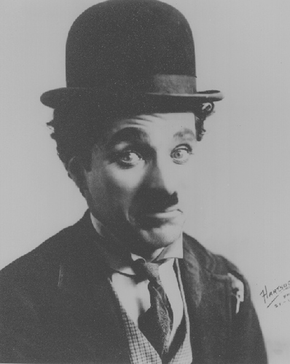
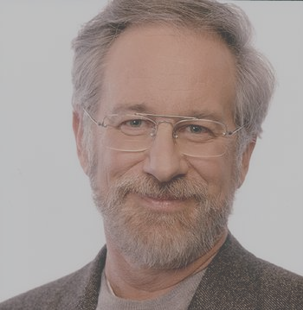

Politics
Business
Entertainment
Science
Sports
Society
Management
Arts
Leadership Excellence
Thoughts From The Greatest Leaders Of All Times
Oprah Winfrey
Charlie Chaplin
Steven Spielberg
Marlon Brando
“Follow your instincts. That's where true wisdom manifests itself.”
Oprah Winfrey
Next

Slide 37
Politics
Business
Entertainment
Science
Sports
Society
Management
Arts
Leadership Excellence
Thoughts From The Greatest Leaders Of All Times
Oprah Winfrey
Charlie Chaplin
Steven Spielberg
Marlon Brando
“The greatest discovery of all time is that a person can change his future by merely changing his attitude.”
Oprah Winfrey
Next

Slide 38
Politics
Business
Entertainment
Science
Sports
Society
Management
Arts
Leadership Excellence
Thoughts From The Greatest Leaders Of All Times
Oprah Winfrey
Charlie Chaplin
Steven Spielberg
Marlon Brando
“Passion is energy. Feel the power that comes from focusing on what excites you.”
Oprah Winfrey
Next

Slide 39
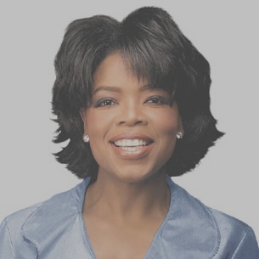
Politics
Business
Entertainment
Science
Sports
Society
Management
Arts
Leadership Excellence
Thoughts From The Greatest Leaders Of All Times
Oprah Winfrey
Charlie Chaplin
Steven Spielberg
Marlon Brando
“A day without laughter is a day wasted.”
Charlie Chaplin
Next

Slide 40
Politics
Business
Entertainment
Science
Sports
Society
Management
Arts
Leadership Excellence
Thoughts From The Greatest Leaders Of All Times
Oprah Winfrey
Charlie Chaplin
Steven Spielberg
Marlon Brando
“I remain just one thing, and one thing only, and that is a clown. It places me on a far higher plane than any politician.”
Charlie Chaplin
Next

Slide 41
Politics
Business
Entertainment
Science
Sports
Society
Management
Arts
Leadership Excellence
Thoughts From The Greatest Leaders Of All Times
Oprah Winfrey
Charlie Chaplin
Steven Spielberg
Marlon Brando
“Nothing is permanent in this wicked world - not even our troubles.”
Charlie Chaplin
Next

Slide 42
Politics
Business
Entertainment
Science
Sports
Society
Management
Arts
Leadership Excellence
Thoughts From The Greatest Leaders Of All Times
Oprah Winfrey
Charlie Chaplin
Steven Spielberg
Marlon Brando
“like the smell of film. I just like knowing there's film going through the camera.”
Steven Spielberg
Next

Slide 43
Politics
Business
Entertainment
Science
Sports
Society
Management
Arts
Leadership Excellence
Thoughts From The Greatest Leaders Of All Times
Oprah Winfrey
Charlie Chaplin
Steven Spielberg
Marlon Brando
“The public has an appetite for anything about imagination - anything that is as far away from reality as is creatively possible.”
Steven Spielberg
Next

Slide 44
Politics
Business
Entertainment
Science
Sports
Society
Management
Arts
Leadership Excellence
Thoughts From The Greatest Leaders Of All Times
Oprah Winfrey
Charlie Chaplin
Steven Spielberg
Marlon Brando
“You have many years ahead of you to create the dreams that we can't even imagine dreaming.”
Steven Spielberg
Next

Slide 45
Politics
Business
Entertainment
Science
Sports
Society
Management
Arts
Leadership Excellence
Thoughts From The Greatest Leaders Of All Times
Oprah Winfrey
Charlie Chaplin
Steven Spielberg
Marlon Brando
“Never confuse the size of your paycheck with the size of your talent. You are much more than your paycheck”
Marlon Brando
Next

Slide 46
Politics
Business
Entertainment
Science
Sports
Society
Management
Arts
Leadership Excellence
Thoughts From The Greatest Leaders Of All Times
Oprah Winfrey
Charlie Chaplin
Steven Spielberg
Marlon Brando
“The only thing an actor owes his public is not to bore them.”
Marlon Brando
Next

Slide 47
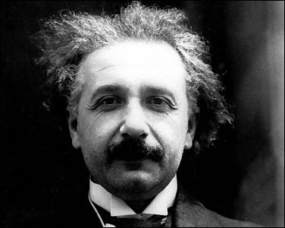
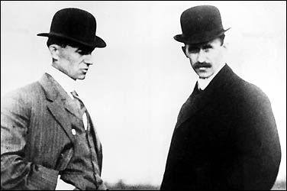
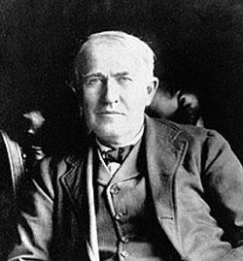
Politics
Business
Entertainment
Science
Sports
Society
Management
Arts
Leadership Excellence
Thoughts From The Greatest Leaders Of All Times
Albert Einstein
Wright Brothers
Thomas Edison
Click on the picture to view their famous quotations

Slide 48
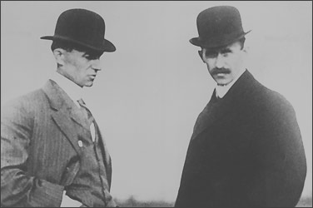
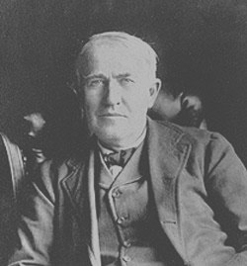
Politics
Business
Entertainment
Science
Sports
Society
Management
Arts
Leadership Excellence
Thoughts From The Greatest Leaders Of All Times
Albert Einstein
Wright Brothers
Thomas Edison
“Only a life lived for others is a life worthwhile.”
Albert Einstein
Next

Slide 49
Politics
Business
Entertainment
Science
Sports
Society
Management
Arts
Leadership Excellence
Thoughts From The Greatest Leaders Of All Times
Albert Einstein
Wright Brothers
Thomas Edison
“Imagination is more important than knowledge.”
Albert Einstein
Next

Slide 50
Politics
Business
Entertainment
Science
Sports
Society
Management
Arts
Leadership Excellence
Thoughts From The Greatest Leaders Of All Times
Albert Einstein
Wright Brothers
Thomas Edison
“Intellectuals solve problems, geniuses prevent them.”
Albert Einstein
Next

Slide 51
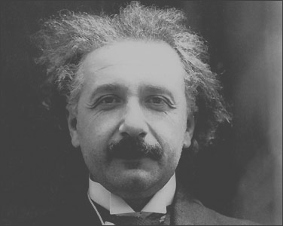
Politics
Business
Entertainment
Science
Sports
Society
Management
Arts
Leadership Excellence
Thoughts From The Greatest Leaders Of All Times
Albert Einstein
Wright Brothers
Thomas Edison
“If we all worked on the assumption that what is accepted as true is really true, there would be little hope of advance.”
Orville Wright
Next

Slide 52
Politics
Business
Entertainment
Science
Sports
Society
Management
Arts
Leadership Excellence
Thoughts From The Greatest Leaders Of All Times
Albert Einstein
Wright Brothers
Thomas Edison
“It is possible to fly without motors, but not without knowledge and skill.”
Wilbur Wright
Next

Slide 53
Politics
Business
Entertainment
Science
Sports
Society
Management
Arts
Leadership Excellence
Thoughts From The Greatest Leaders Of All Times
Albert Einstein
Wright Brothers
Thomas Edison
“I have not failed. I've just found 10,000 ways that won't work.”
Thomas Edison
Next

Slide 54
Politics
Business
Entertainment
Science
Sports
Society
Management
Arts
Leadership Excellence
Thoughts From The Greatest Leaders Of All Times
Albert Einstein
Wright Brothers
Thomas Edison
“I never did a day's work in my life. It was all fun.”
Thomas Edison
Next

Slide 55
Politics
Business
Entertainment
Science
Sports
Society
Management
Arts
Leadership Excellence
Thoughts From The Greatest Leaders Of All Times
Albert Einstein
Wright Brothers
Thomas Edison
“The three great essentials to achieve anything worth while are: Hard work, Stick-to-itiveness, and Common sense.”
Thomas Edison
Next

Slide 56
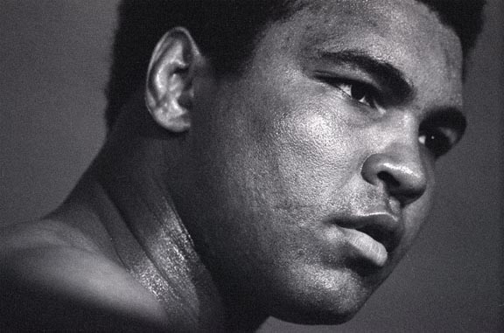
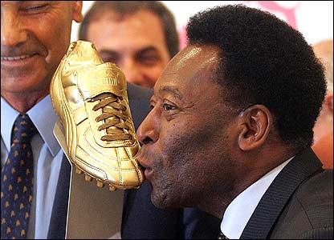
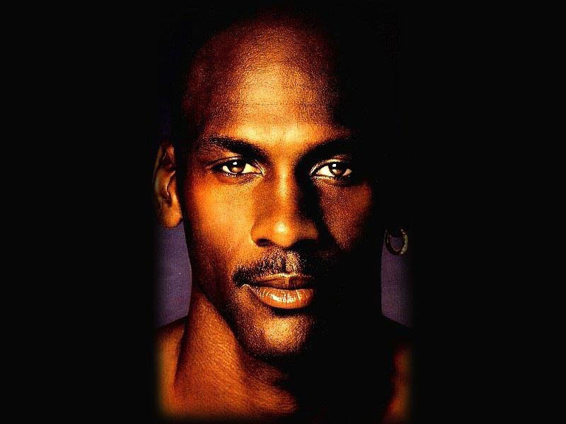
Politics
Business
Entertainment
Science
Sports
Society
Management
Arts
Leadership Excellence
Thoughts From The Greatest Leaders Of All Times
Mohammed Ali
Pele
Michael Jordan
Click on the picture to view their famous quotations

Slide 57
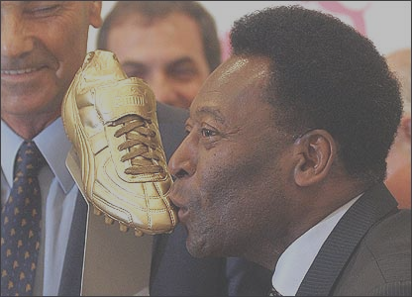
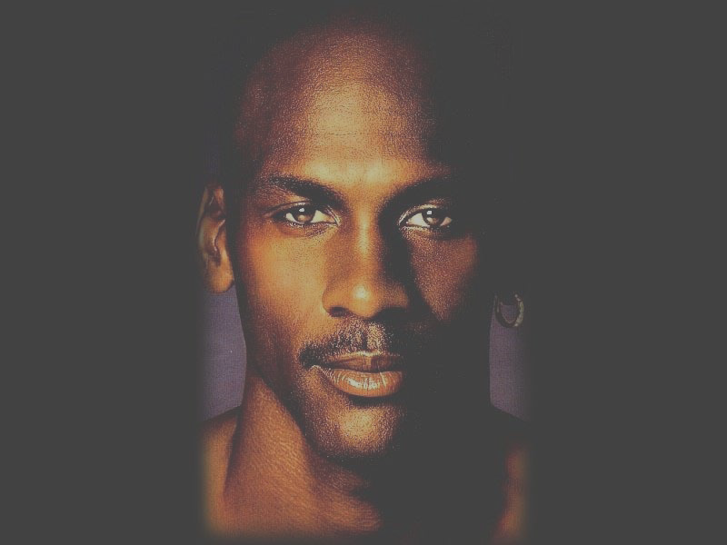
Politics
Business
Entertainment
Science
Sports
Society
Management
Arts
Leadership Excellence
Thoughts From The Greatest Leaders Of All Times
Mohammed Ali
Pele
Michael Jordan
“I am the greatest, I said that even before I knew I was.”
Mohammed Ali
Next

Slide 58
Politics
Business
Entertainment
Science
Sports
Society
Management
Arts
Leadership Excellence
Thoughts From The Greatest Leaders Of All Times
Mohammed Ali
Pele
Michael Jordan
“He who is not courageous enough to take risks will accomplish nothing in life.”
Mohammed Ali
Next

Slide 59
Politics
Business
Entertainment
Science
Sports
Society
Management
Arts
Leadership Excellence
Thoughts From The Greatest Leaders Of All Times
Mohammed Ali
Pele
Michael Jordan
“It's lack of faith that makes people afraid of meeting challenges, and I believed in myself.”
Mohammed Ali
Next

Slide 60
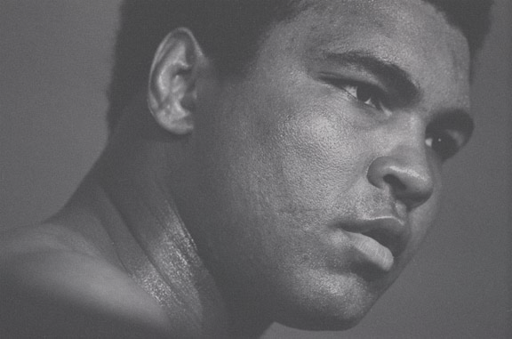
Politics
Business
Entertainment
Science
Sports
Society
Management
Arts
Leadership Excellence
Thoughts From The Greatest Leaders Of All Times
Mohammed Ali
Pele
Michael Jordan
“Enthusiasm is everything. It must be taut and vibrating like a guitar string.”
Pele
Next

Slide 61
Politics
Business
Entertainment
Science
Sports
Society
Management
Arts
Leadership Excellence
Thoughts From The Greatest Leaders Of All Times
Mohammed Ali
Pele
Michael Jordan
“I've come to accept that the life of a frontrunner is a hard one, that he will suffer more injuries than most men and that many of these injuries will not be accidental, but I shall fight them out.”
Pele
Next

Slide 62
Politics
Business
Entertainment
Science
Sports
Society
Management
Arts
Leadership Excellence
Thoughts From The Greatest Leaders Of All Times
Mohammed Ali
Pele
Michael Jordan
“Everything is practice”
Pele
Next

Slide 63
Politics
Business
Entertainment
Science
Sports
Society
Management
Arts
Leadership Excellence
Thoughts From The Greatest Leaders Of All Times
Mohammed Ali
Pele
Michael Jordan
“Always turn a negative situation into a positive situation.”
Michael Jordan
Next

Slide 64
Politics
Business
Entertainment
Science
Sports
Society
Management
Arts
Leadership Excellence
Thoughts From The Greatest Leaders Of All Times
Mohammed Ali
Pele
Michael Jordan
There is no ‘I’ in ‘TEAM’ but there is an ‘I’ in ‘WIN’.
Michael Jordan
Next

Slide 65
Politics
Business
Entertainment
Science
Sports
Society
Management
Arts
Leadership Excellence
Thoughts From The Greatest Leaders Of All Times
Mohammed Ali
Pele
Michael Jordan
“I've failed over and over and over again in my life and that is why I succeed.”
Michael Jordan
Next

Slide 66
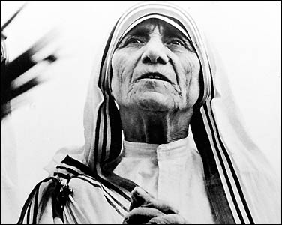
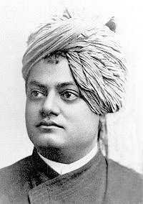
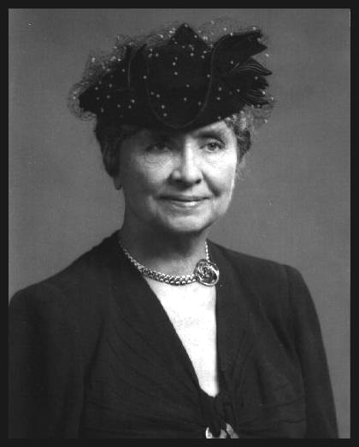
Politics
Business
Entertainment
Science
Sports
Society
Management
Arts
Leadership Excellence
Thoughts From The Greatest Leaders Of All Times
Mother Teresa
Swami Vivekananda
Helen Keller
Click on the picture to view their famous quotations

Slide 67
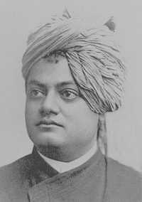
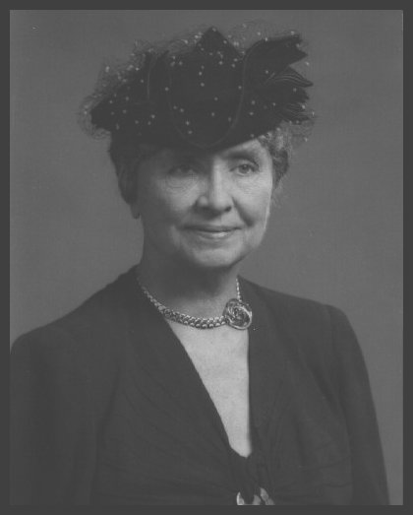
Politics
Business
Entertainment
Science
Sports
Society
Management
Arts
Leadership Excellence
Thoughts From The Greatest Leaders Of All Times
Mother Teresa
Swami Vivekananda
Helen Keller
“If you judge people, you have no time to love them.”
Mother Teresa
Next

Slide 68
Politics
Business
Entertainment
Science
Sports
Society
Management
Arts
Leadership Excellence
Thoughts From The Greatest Leaders Of All Times
Mother Teresa
Swami Vivekananda
Helen Keller
“There is more hunger in the world for love and appreciation in this world than for bread.”
Mother Teresa
Next

Slide 69
Politics
Business
Entertainment
Science
Sports
Society
Management
Arts
Leadership Excellence
Thoughts From The Greatest Leaders Of All Times
Mother Teresa
Swami Vivekananda
Helen Keller
“We shall never know all the good that a simple smile can do.”
Mother Teresa
Next

Slide 70
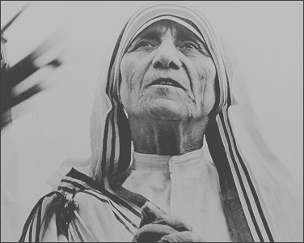
Politics
Business
Entertainment
Science
Sports
Society
Management
Arts
Leadership Excellence
Thoughts From The Greatest Leaders Of All Times
Mother Teresa
Swami Vivekananda
Helen Keller
“Condemn none: if you can stretch out a helping hand, do so. If you cannot, fold your hands, bless your brothers, and let them go their own way.”
Swami Vivekananda
Next

Slide 71
Politics
Business
Entertainment
Science
Sports
Society
Management
Arts
Leadership Excellence
Thoughts From The Greatest Leaders Of All Times
Mother Teresa
Swami Vivekananda
Helen Keller
“If money help a man to do good to others, it is of some value; but if not, it is simply a mass of evil, and the sooner it is got rid of, the better.”
Swami Vivekananda
Next

Slide 72
Politics
Business
Entertainment
Science
Sports
Society
Management
Arts
Leadership Excellence
Thoughts From The Greatest Leaders Of All Times
Mother Teresa
Swami Vivekananda
Helen Keller
“Take up one idea. Make that one idea your life - think of it, dream of it, live on idea. Let the brain, muscles, nerves, every part of your body, be full of that idea, and just leave every other idea alone. This is the way to success.”
Swami Vivekananda
Next

Slide 73
Politics
Business
Entertainment
Science
Sports
Society
Management
Arts
Leadership Excellence
Thoughts From The Greatest Leaders Of All Times
Mother Teresa
Swami Vivekananda
Helen Keller
“Never think there is anything impossible for the soul. It is the greatest heresy to think so. If there is sin, this is the only sin; to say that you are weak, or others are weak.”
Swami Vivekananda
Next

Slide 74
Politics
Business
Entertainment
Science
Sports
Society
Management
Arts
Leadership Excellence
Thoughts From The Greatest Leaders Of All Times
Mother Teresa
Swami Vivekananda
Helen Keller
“Arise, Awake and stop not till the goal is achieved”
Swami Vivekananda
Next

Slide 75
Politics
Business
Entertainment
Science
Sports
Society
Management
Arts
Leadership Excellence
Thoughts From The Greatest Leaders Of All Times
Mother Teresa
Swami Vivekananda
Helen Keller
“Life is an exciting business, and most exciting when it is lived for others.”
Helen Keller
Next

Slide 76
Politics
Business
Entertainment
Science
Sports
Society
Management
Arts
Leadership Excellence
Thoughts From The Greatest Leaders Of All Times
Mother Teresa
Swami Vivekananda
Helen Keller
“It is a terrible thing to see and have no vision.”
Helen Keller
Next

Slide 77
Politics
Business
Entertainment
Science
Sports
Society
Management
Arts
Leadership Excellence
Thoughts From The Greatest Leaders Of All Times
Mother Teresa
Swami Vivekananda
Helen Keller
“Keep your face to the sunshine and you cannot see a shadow.”
Helen Keller
Next

Slide 78
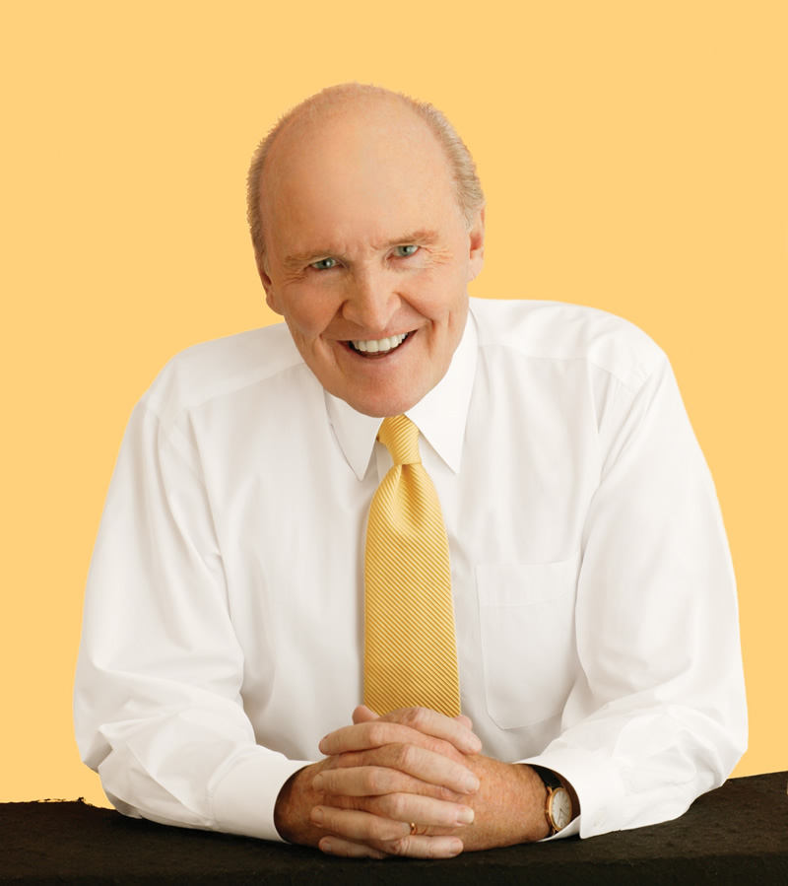
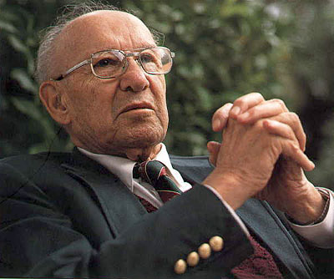
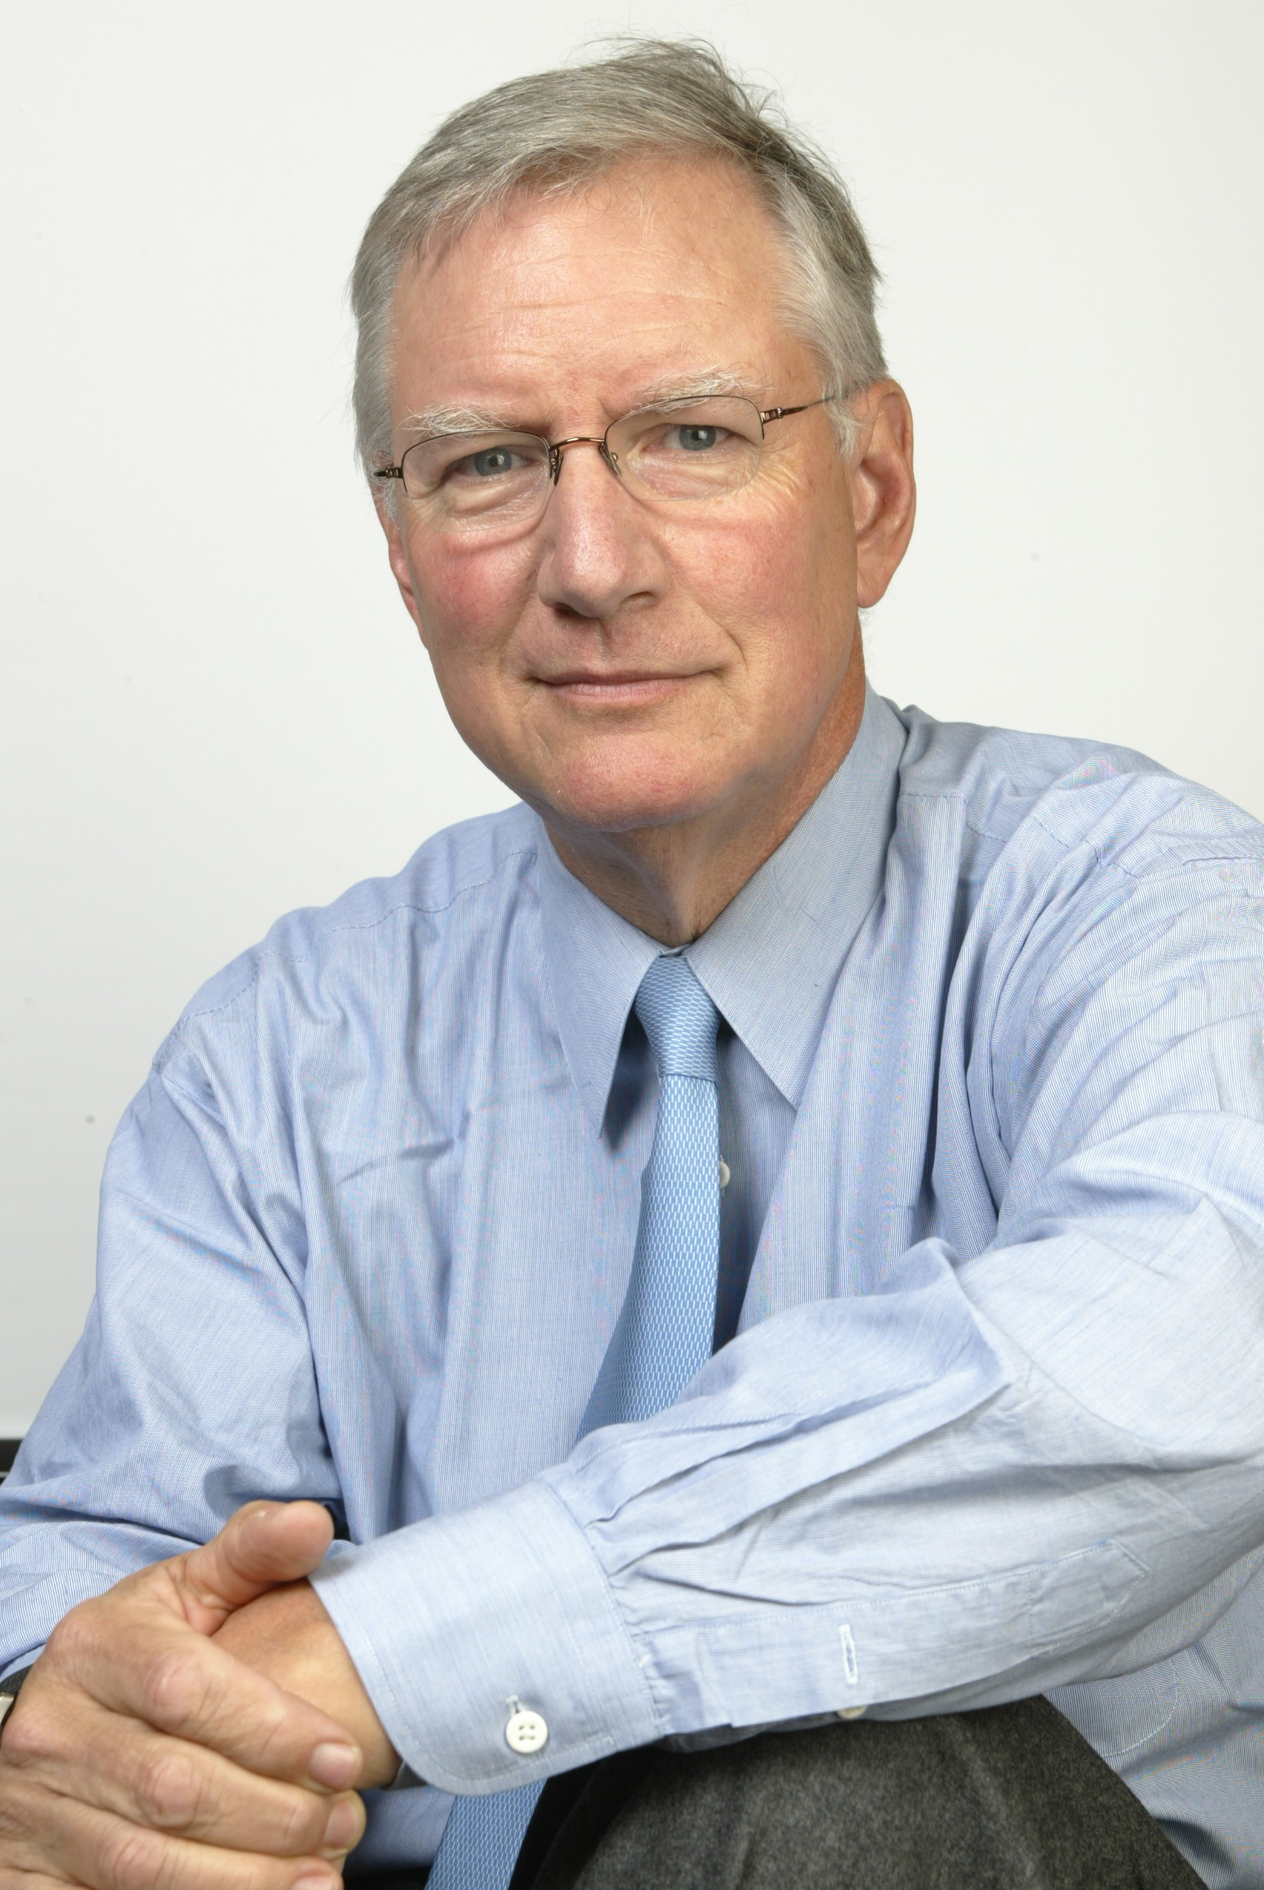
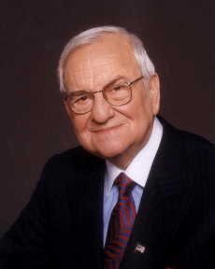
Politics
Business
Entertainment
Science
Sports
Society
Management
Arts
Leadership Excellence
Thoughts From The Greatest Leaders Of All Times
Jack Welch
Peter Drucker
Tom Peters
Lee Iacocca
Click on the picture to view their famous quotations

Slide 79
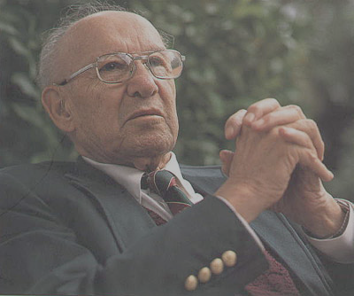
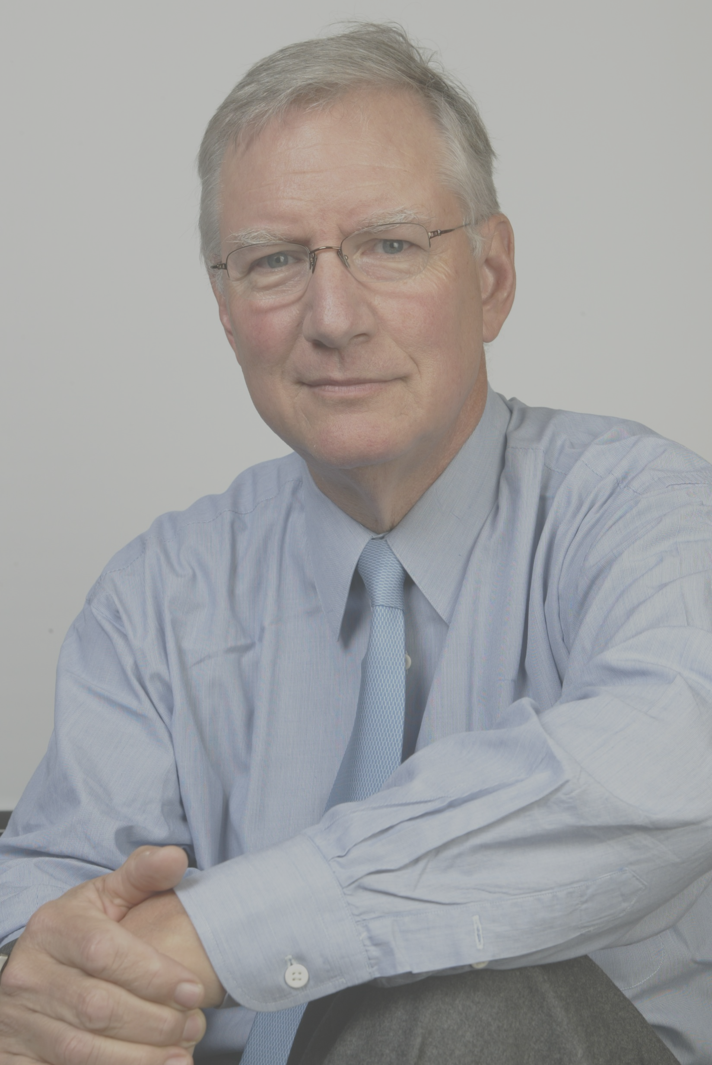
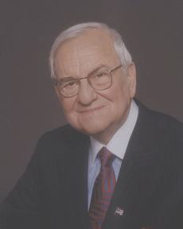
Politics
Business
Entertainment
Science
Sports
Society
Management
Arts
Leadership Excellence
Thoughts From The Greatest Leaders Of All Times
Jack Welch
Peter Drucker
Tom Peters
Lee Iacocca
“If you pick the right people and give them the opportunity to spread their wings and put compensation as a carrier behind it you almost don't have to manage them.”
Jack Welch
Next

Slide 80
Politics
Business
Entertainment
Science
Sports
Society
Management
Arts
Leadership Excellence
Thoughts From The Greatest Leaders Of All Times
Jack Welch
Peter Drucker
Tom Peters
Lee Iacocca
“If you don't have a competitive advantage, don't compete.”
Jack Welch
Next

Slide 81
Politics
Business
Entertainment
Science
Sports
Society
Management
Arts
Leadership Excellence
Thoughts From The Greatest Leaders Of All Times
Jack Welch
Peter Drucker
Tom Peters
Lee Iacocca
“Control your own destiny or someone else will.”
Jack Welch
Next

Slide 82

Politics
Business
Entertainment
Science
Sports
Society
Management
Arts
Leadership Excellence
Thoughts From The Greatest Leaders Of All Times
Jack Welch
Peter Drucker
Tom Peters
Lee Iacocca
“Knowledge has to be improved, challenged, and increased constantly, or it vanishes”
Peter Drucker
Next

Slide 83
Politics
Business
Entertainment
Science
Sports
Society
Management
Arts
Leadership Excellence
Thoughts From The Greatest Leaders Of All Times
Jack Welch
Peter Drucker
Tom Peters
Lee Iacocca
“Plans are only good intentions unless they immediately degenerate into hard work.”
Peter Drucker
Next

Slide 84
Politics
Business
Entertainment
Science
Sports
Society
Management
Arts
Leadership Excellence
Thoughts From The Greatest Leaders Of All Times
Jack Welch
Peter Drucker
Tom Peters
Lee Iacocca
“Effective leadership is not about making speeches or being liked; leadership is defined by results not attributes.”
Peter Drucker
Next

Slide 85
Politics
Business
Entertainment
Science
Sports
Society
Management
Arts
Leadership Excellence
Thoughts From The Greatest Leaders Of All Times
Jack Welch
Peter Drucker
Tom Peters
Lee Iacocca
“The best way to predict the future is to create it.”
Peter Drucker
Next

Slide 86
Politics
Business
Entertainment
Science
Sports
Society
Management
Arts
Leadership Excellence
Thoughts From The Greatest Leaders Of All Times
Jack Welch
Peter Drucker
Tom Peters
Lee Iacocca
“Leaders don't create followers, they create more leaders.”
Tom Peters
Next

Slide 87
Politics
Business
Entertainment
Science
Sports
Society
Management
Arts
Leadership Excellence
Thoughts From The Greatest Leaders Of All Times
Jack Welch
Peter Drucker
Tom Peters
Lee Iacocca
“Excellent firms don't believe in excellence - only in constant improvement and constant change.”
Tom Peters
Next

Slide 88
Politics
Business
Entertainment
Science
Sports
Society
Management
Arts
Leadership Excellence
Thoughts From The Greatest Leaders Of All Times
Jack Welch
Peter Drucker
Tom Peters
Lee Iacocca
“Winners must learn to relish change with the same enthusiasm and energy that we have resisted it in the past.”
Tom Peters
Next

Slide 89
Politics
Business
Entertainment
Science
Sports
Society
Management
Arts
Leadership Excellence
Thoughts From The Greatest Leaders Of All Times
Jack Welch
Peter Drucker
Tom Peters
Lee Iacocca
“In times of great stress or adversity, it's always best to keep busy, to plow your anger and your energy into something positive.”
Lee Iacocca
Next

Slide 90
Politics
Business
Entertainment
Science
Sports
Society
Management
Arts
Leadership Excellence
Thoughts From The Greatest Leaders Of All Times
Jack Welch
Peter Drucker
Tom Peters
Lee Iacocca
“The greatest discovery of my generation is that human beings can alter their lives by altering their attitudes of mind.”
Lee Iacocca
Next

Slide 91
Politics
Business
Entertainment
Science
Sports
Society
Management
Arts
Leadership Excellence
Thoughts From The Greatest Leaders Of All Times
Jack Welch
Peter Drucker
Tom Peters
Lee Iacocca
“Apply yourself. Get all the education you can, but then, by God, do something. Don't just stand there, make it happen.”
Lee Iacocca
Next

Slide 92
Politics
Business
Entertainment
Science
Sports
Society
Management
Arts
Leadership Excellence
Thoughts From The Greatest Leaders Of All Times
Jack Welch
Peter Drucker
Tom Peters
Lee Iacocca
“Motivation is everything. You can do the work of two people, but you can't be two people. Instead, you have to inspire the next guy down the line and get him to inspire his people.”
Lee Iacocca
Next

Slide 93
Politics
Business
Entertainment
Science
Sports
Society
Management
Arts
Leadership Excellence
Thoughts From The Greatest Leaders Of All Times
Jack Welch
Peter Drucker
Tom Peters
Lee Iacocca
“Talk to people in their own language. If you do it well, they'll say, 'God, he said exactly what I was thinking.' And when they begin to respect you, they'll follow you always”
Lee Iacocca
Next

Slide 94
Politics
Business
Entertainment
Science
Sports
Society
Management
Arts
Leadership Excellence
Thoughts From The Greatest Leaders Of All Times
Jack Welch
Peter Drucker
Tom Peters
Lee Iacocca
“We are continually faced by great opportunities brilliantly disguised as insoluble problems.”
Lee Iacocca
Next

Slide 95
Politics
Business
Entertainment
Science
Sports
Society
Management
Arts
Leadership Excellence
Thoughts From The Greatest Leaders Of All Times
Jack Welch
Peter Drucker
Tom Peters
Lee Iacocca
“You can have brilliant ideas, but if you can't get them across, your ideas won't get you anywhere.”
Lee Iacocca
Next

Slide 96


Politics
Business
Entertainment
Science
Sports
Society
Management
Arts
Leadership Excellence
Thoughts From The Greatest Leaders Of All Times
Michelangelo
Leonardo Da Vinci
Click on the picture to view their famous quotations

Slide 97

Politics
Business
Entertainment
Science
Sports
Society
Management
Arts
Leadership Excellence
Thoughts From The Greatest Leaders Of All Times
Michelangelo
Leonardo Da Vinci
“The greater danger for most of us lies not in setting our aim too high and falling short; but in setting our aim too low, and achieving our mark.”
Michelangelo
Next

Slide 98
Politics
Business
Entertainment
Science
Sports
Society
Management
Arts
Leadership Excellence
Thoughts From The Greatest Leaders Of All Times
Michelangelo
Leonardo Da Vinci
“Lord, grant that I may always desire more than I can accomplish.”
Michelangelo
Next

Slide 99

Politics
Business
Entertainment
Science
Sports
Society
Management
Arts
Leadership Excellence
Thoughts From The Greatest Leaders Of All Times
Michelangelo
Leonardo Da Vinci
“I have offended God and mankind because my work didn't reach the quality it should have.”
Leonardo Da Vinci
Next

Slide 100
Politics
Business
Entertainment
Science
Sports
Society
Management
Arts
Leadership Excellence
Thoughts From The Greatest Leaders Of All Times
Michelangelo
Leonardo Da Vinci
“I have been impressed with the urgency of doing. Knowing is not enough; we must apply. Being willing is not enough; we must do.”
Leonardo Da Vinci

